Slide 1
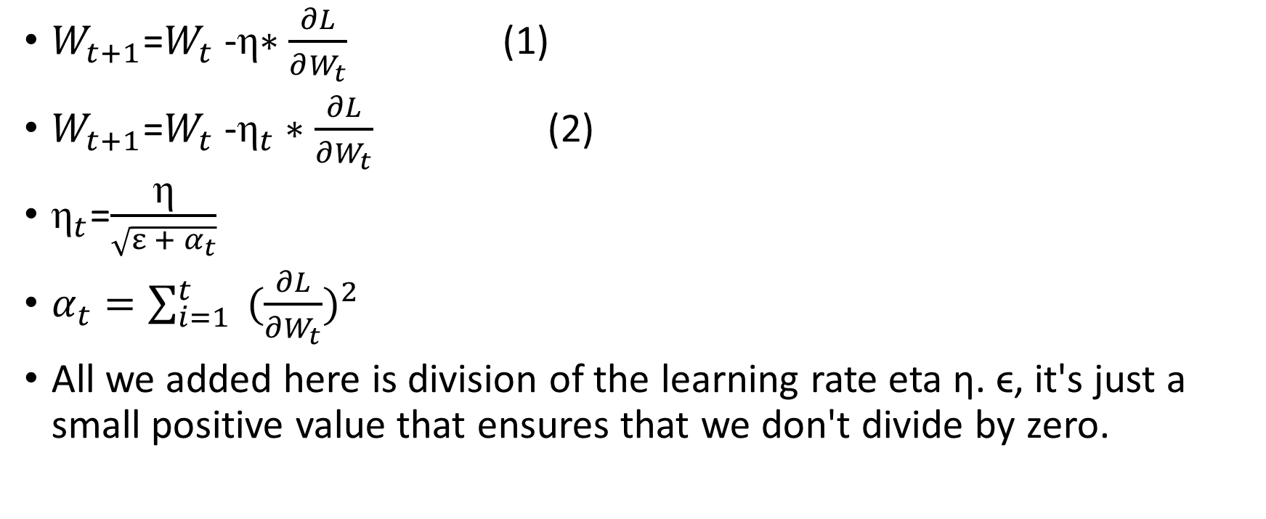
AdaGrad
$W_{t+1}$=$W_{t}$ -η$∗\frac{∂L}{∂W_{t}}$ (1)
$W_{t+1}$=$W_{t}$ -${\text{η}}_{t}∗\frac{∂L}{∂W_{t}}$ (2)
${\text{η}}_{t}$=$\frac{\text{η}}{\sqrt{ε + α_{t}}}$
$α_{t}=\sum_{i=1}^{t}{ {(\frac{∂L}{∂W_{t}})}^{2} }$
All we added here is division of the learning rate eta η. ϵ, it's just a small positive value that ensures that we don't divide by zero.

Slide 2
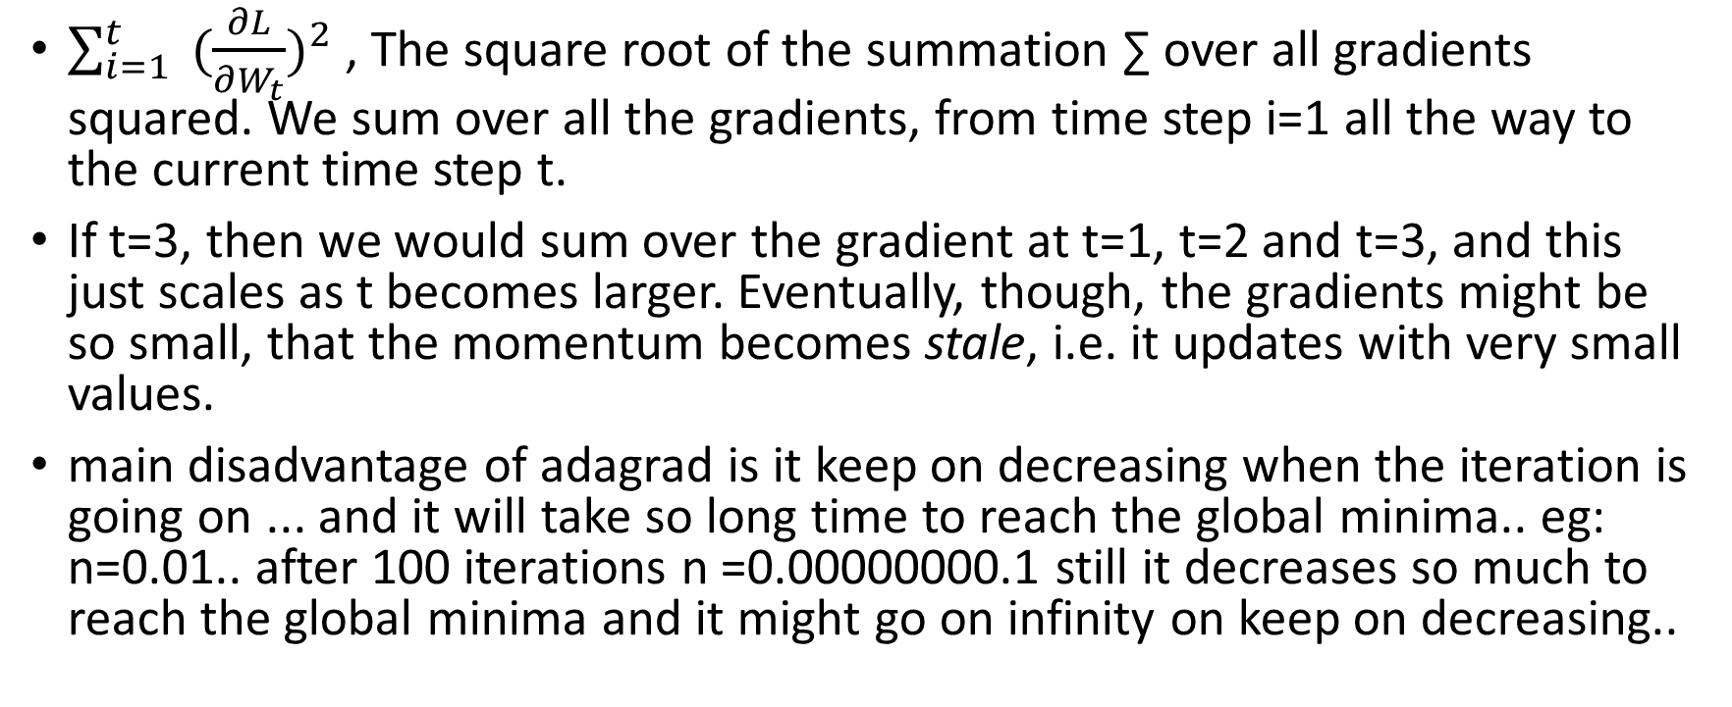
$\sum_{i=1}^{t}{ {(\frac{∂L}{∂W_{t}})}^{2} }$, The square root of the summation ∑ over all gradients squared. We sum over all the gradients, from time step i=1 all the way to the current time step t.
If t=3, then we would sum over the gradient at t=1, t=2 and t=3, and this just scales as t becomes larger. Eventually, though, the gradients might be so small, that the momentum becomes stale, i.e. it updates with very small values.
main disadvantage of adagrad is it keep on decreasing when the iteration is going on ... and it will take so long time to reach the global minima.. eg: n=0.01.. after 100 iterations n =0.00000000.1 still it decreases so much to reach the global minima and it might go on infinity on keep on decreasing..

